Slide 1

SIR C R REDDY COLLEGE OF ENGINEERING
DEPARTMENT OF INFORMATION TECHNOLOGY
HUMAN STRESS DETECTION BASED ON STABLE PHYSCOLOGICAL TRAITS
Project Guide:
Dr. K. Satyanarayana
Assoc Professor
Dept of IT
Presented By:
P.Anuhya (20B81A1295)
M.Durga Sireesha (20B81A1264)
M.Rakesh (21B85A1208)
Sk.Chan Bhasha (20B81A12A7)
B5

Slide 2
AGENDA
Abstract
Existing System
Problem Statement
Proposed System
Requirement Specification
Methodology
System Architecture
Dataset Description
Classification Analysis
Metrics of Comparision
Implementation
Result
Conclusion

Slide 3
ABSTRACT
For every human , stress is a physical and mental reaction caused due to feelings such as depression, anxiety-disorders, and bipolar disorders . In this project We aimed at developing machine learning models to predict human stress based on their individual psychological responses using various algorithms such as Naive Bayes, Decision Tree, SVM Algorithm, Neural Network Algorithm and Random Forest Algorithm on the dataset to detect the human stress.

Slide 4
EXISTING SYSTEM:
In daily life stress is a major problem to many people. It is a growing issue and it has become an unavoidable part of our daily lives. Now a days we have automatic stress monitoring scheme which exploits smart wearable devices and advanced effective computing algorithms. In the existing system work on stress detection is based on the digital signal processing, talking into consideration galvanic skin response, blood volume, pupil dilation and skin temperature. The other work on this issue based on several physiological signals and visual features to monitor the stress in person while person is working. Previous studies have shown that using social media for healthcare, especially for detecting stress, is possible.

Slide 5
PROBLEM STATEMENT
Predicting Perceived Stress aims to develop a predictive model that can accurately forecast the level of perceived stress experienced by individuals. Develop a comprehensive human stress detection system that leverages stable physiological traits, integrating emotional states such as happiness and sadness. Utilize a multi-modal approach, implement machine learning algorithms to classify stress based on these physiological and emotional cues. Design a user-friendly interface based on detected emotions. Ensuring the system's reliability and accuracy. Collaborating with machine learning to refine the model and enhance its effectiveness in detecting and managing human stress.

Slide 6
PROPOSED SYSTEM
We aimed at developing machine learning models to predict individual psychological responses, based on psychological variables with maximal sensitivity in classifying subjects with perceived stress. It leveraged machine learning techniques to identify people at the greatest risk of developing severe and negative psychological outcomes. In this proposed system, the data was collected through self-survey.

Slide 7
REQUIREMENT SPECIFICATION
SOFTWARE :
Operating System : Windows 11
Front end : HTML,CSS,JS
Back end : Python 3.6
Data base : PostgreSQL
IDE : VS CODE
HARDWARE :
Processor : i3 Minimum
RAM : 4 GB (minimum)
Hard Disk : 500 GB

Slide 8
METHODOLOGY
The major goal of this proposed system is to create a system that can predict human stress r based on the inputs. This work proposed system to accomplish these goals, this system is designed with modules for users and admin. We created a framework diagram, shown in the following figure, to represent the proposed system's methodology.

Slide 9
SYSTEM ARCHITECTURE
Training data
Emotion dataset
Machine learning Algorithms
Pre-processing
Survey
Test data
Predict Emotion

Slide 10
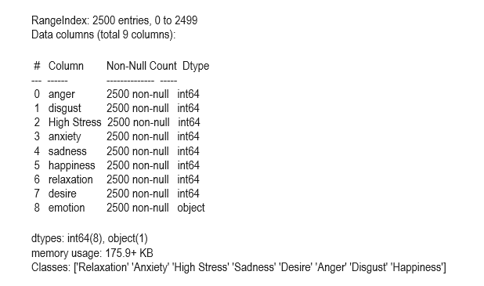
DATASET DESCRIPTION
This supervised dataset has 9 columns, namely, anger, disgust, High Stress, anxiety, sadness, happiness, relaxation, desire, and emotion. 'Relaxation', 'Anxiety', 'High, Stress', 'Sadness', 'Desire', 'Anger', 'Disgust', 'Happiness' are the eight categories of emotions that make up the 2500 rows of data that make up this dataset. This dataset takes up 175 KB of Memory space.

Slide 11
CLASSIFICATION ANALYSIS
When employing a machine learning model to predict stress emotion from test inputs, it is necessary to analyze the classification to find the most accurate classification model. For this investigation, five machine learning algorithms were employed to classify supervised emotion dataset which labeled with eight emotions ('Relaxation', 'Anxiety', 'High, Stress', 'Sadness', 'Desire', 'Anger', 'Disgust', 'Happiness').
Naive Bayes
Decision Tree
SVM Algorithm
Neural Network Algorithm
Random Forest Algorithm

Slide 12
TRAINING
At this step, the system trains with several classifiers on the supervised emotion dataset. Five previously stated machine learning algorithms were used for this training procedure to categorize a supervised emotion dataset that was labeled with eight emotions. This dataset is divided into training and testing units in a 70:30 ratio. The 30% testing dataset's values were predicted using the training model files.

Slide 13
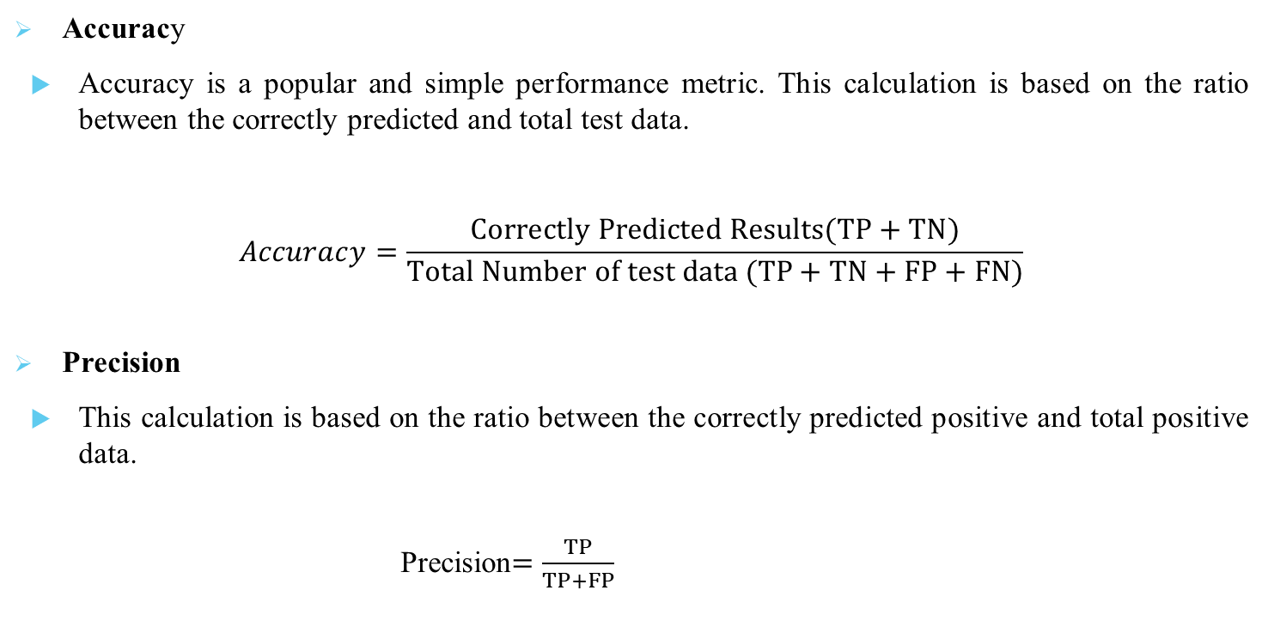
METRICS OF COMPARISION
Accuracy
Accuracy is a popular and simple performance metric. This calculation is based on the ratio between the correctly predicted and total test data.
$$Accuracy=\frac{Correctly Predicted Results(TP+TN)}{Total Number of test data (TP+TN+FP+FN)}$$
Precision
This calculation is based on the ratio between the correctly predicted positive and total positive data.
Precision$=\frac{TP}{TP+FP}$

Slide 14

Recall
This calculation is based on the ratio between the correctly predicted positive and true positive and false positive data.
$$Recall =\frac{TP }{TP+FP}$$
F1-socre
This calculation is based on the results of precision and recall.
f$1−score =2∗\frac{(Precision∗Recall) }{Precision+Recall}$

Slide 15
IMPLEMENTATION

Slide 16
LIBRARIES
PANDAS: The Pandas library in Python is primarily used for data manipulation and analysis. It provides powerful data structures like DataFrame and Series, along with functions to clean, transform, and analyze data efficiently.
NUMPY: NumPy is a Python library used for working with arrays. It also has functions for working in domain of linear algebra, Fourier transform, and matrices. It is an opensource project and you can use it freely. NumPy stands for Numerical Python.
Matplotlib: matplotlib is a collection of functions that make matplotlib work like MATLAB. Each pyplot function makes some change to a figure: e.g., creates a figure, creates a plotting area in a figure, plots some lines in a plotting area, decorates the plot with labels, etc.

Slide 17
Sklearn: Scikit-learn, also known as sklearn, is an open-source, machine learning and data modeling library for Python. It features various classification, regression and clustering algorithms including support vector machines, random forests, gradient boosting, k-means and DBSCAN, and is designed to interoperate with the Python libraries, NumPy and SciPy.
MySql.connector: mysql.connector is a Python library that provides an interface for connecting to MySQL databases from Python programs. It allows you to interact with MySQL databases by providing functionalities to execute SQL queries, fetch results, manage transactions, and handle database connections. This library simplifies the process of working with MySQL databases in Python, making it easier for developers to build applications that need to store, retrieve, and manipulate data in MySQL databases. It is commonly used in web development, data analysis, and other applications where interaction with MySQL databases is required.

Slide 18
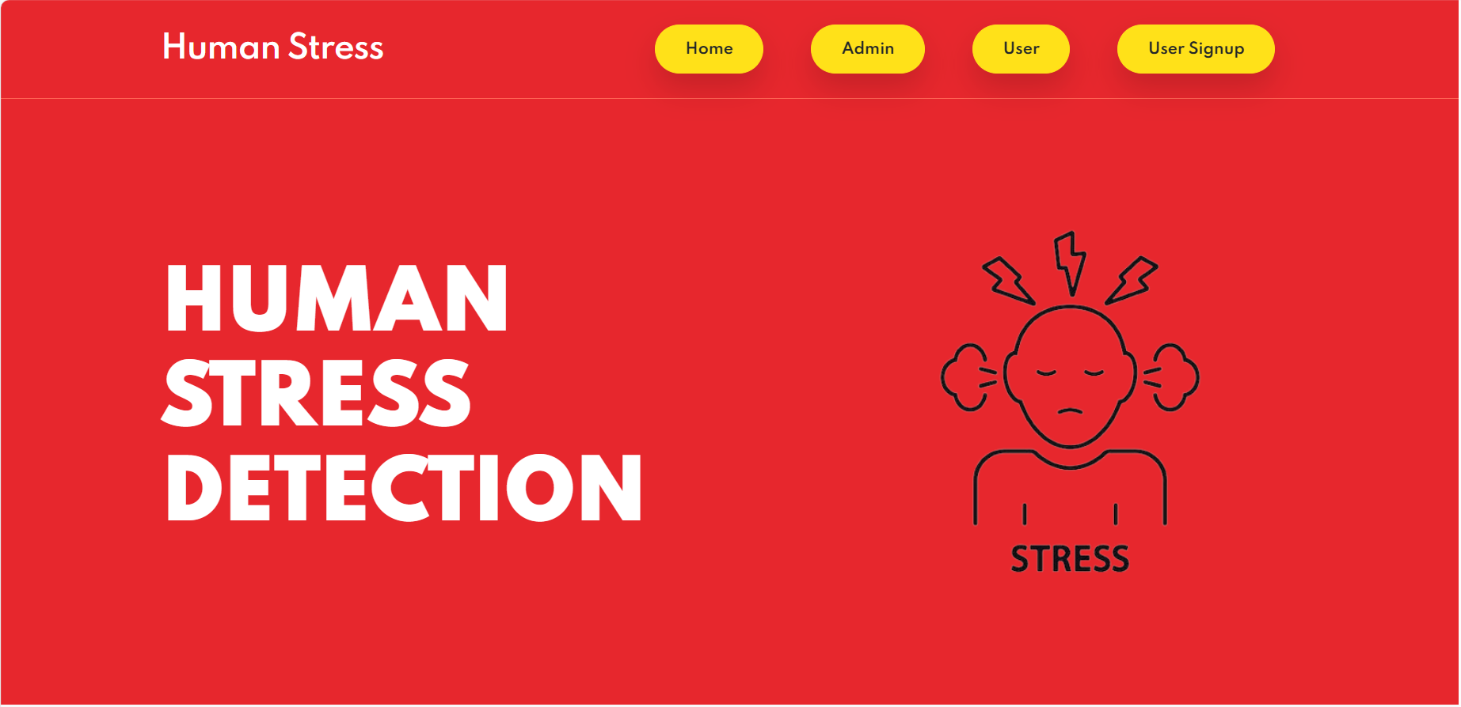
HOME PAGE

Slide 19
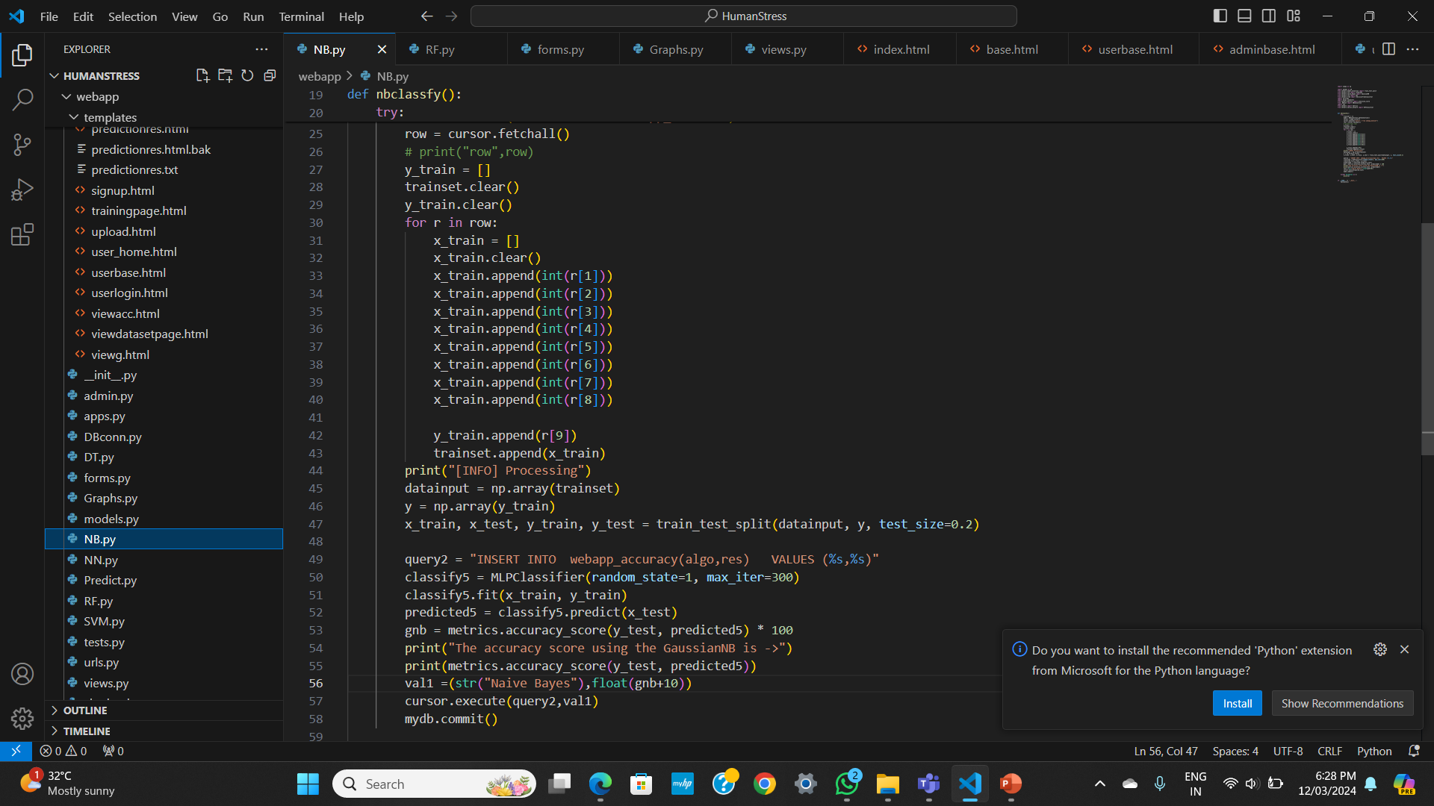

Slide 20
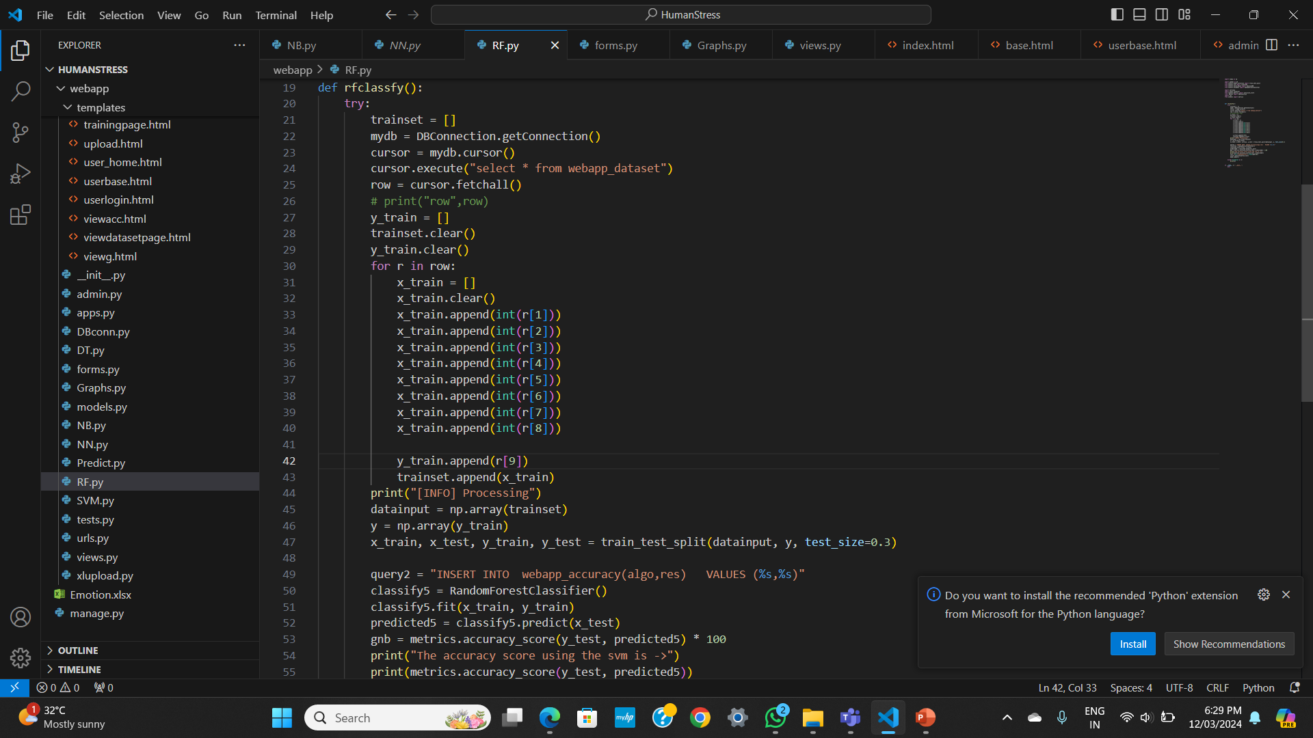

Slide 21
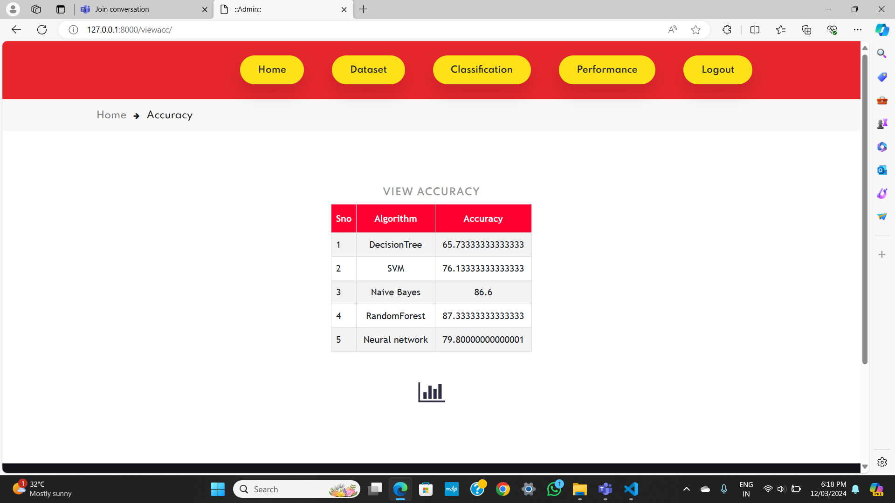

Slide 22
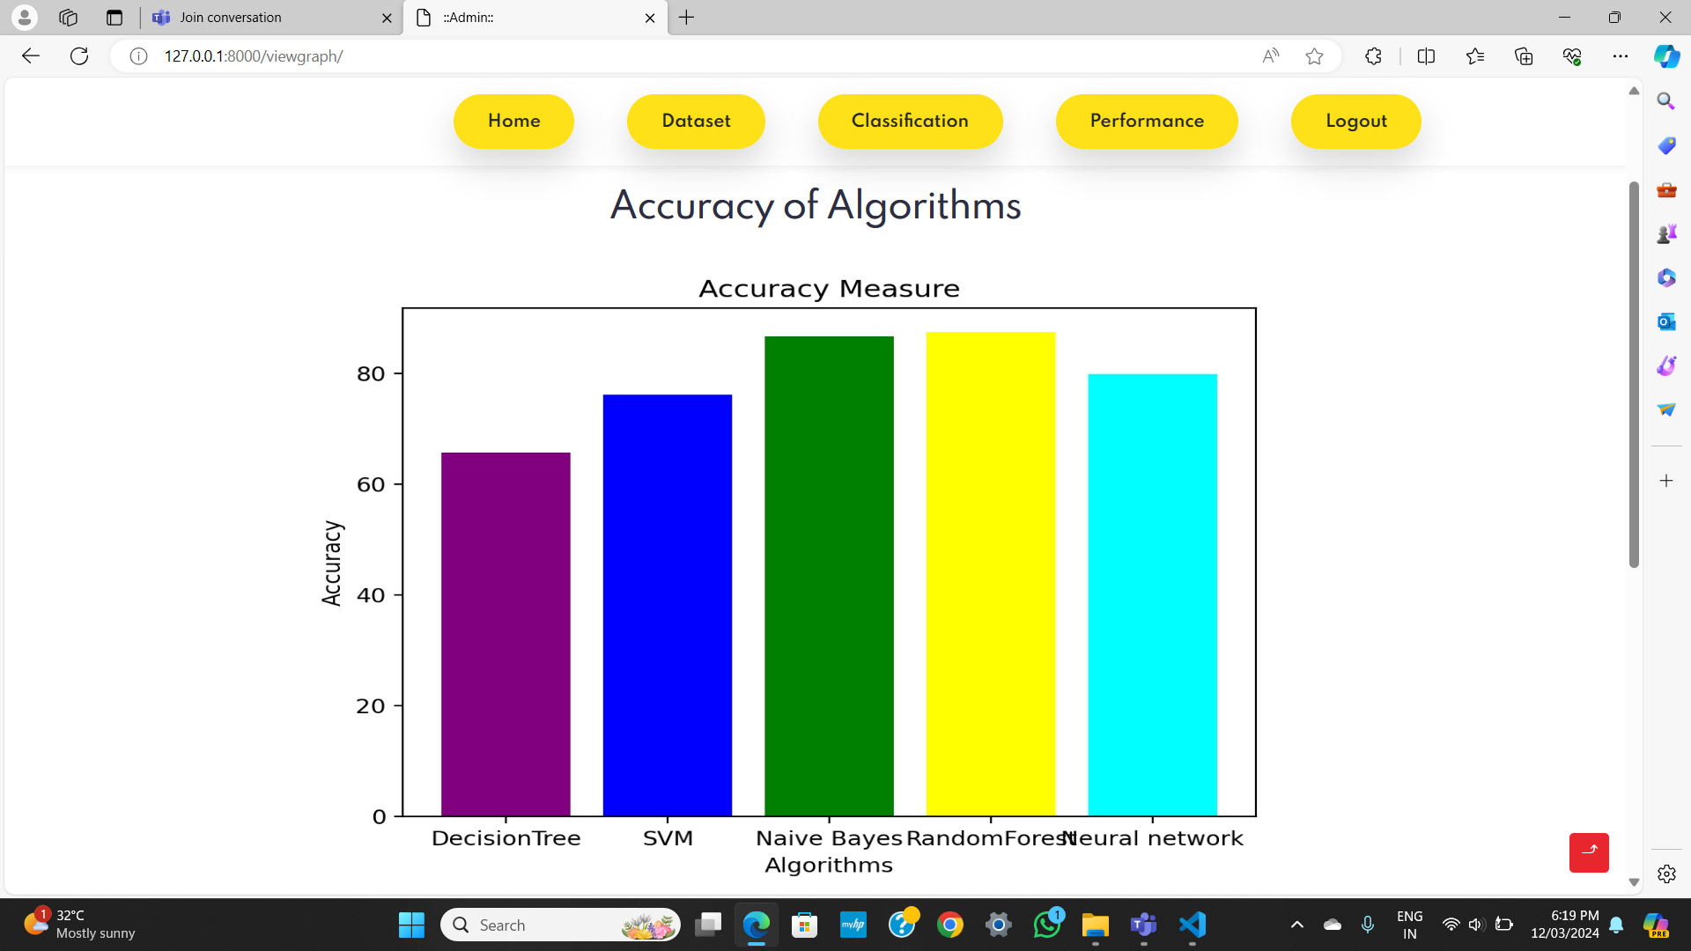

Slide 23
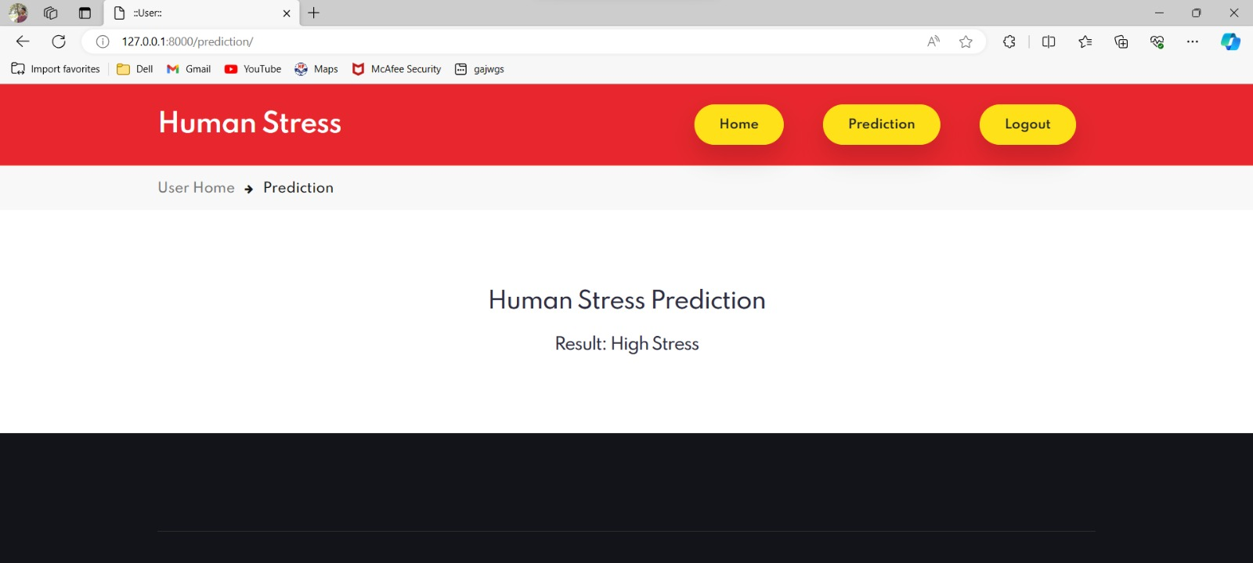
RESULT

Slide 24
CONCLUSION
The present study measured the impact on perceived levels of stress, taking into account sociodemographic variables and stable psychological traits. The results confirmed that participants perceived as a stressful experience in the present sample, the level of perceived stress was higher than that of the general population. Indeed, almost 30% of the sample scored above the results from the normative data on measures of perceived stress. These results are in line with the findings of recent studies on the psychological impact of the international literature on epidemic outbreaks. The mean values of the single items in addition to nervousness and stress, feelings of being unable to control one’s personal life accounted for the majority of participants’ perceived stress. This suggests that the unpredictability and uncontrollability of the psychological impacts may play a significant role in determining levels of perceived stress. It is designed for analysing the mental health issues faced by user and recommends user with respect to their emotions.

Slide 25
THANK YOU

